Slide 1
College Council
April 7, 2022

Slide 2
Constituency Reports

Slide 3
Reporting Committees

Slide 4
Facilities – Cody Pauxtis
Next meeting: April 20 April

Slide 5
Safety & Security – Kevin King
Presented CFIT to President's Cabinet
Cost analysis needed
Presented CFIT to Safety Committee
Currently working final recommendation
Coverage needs
Training requirements
Current issues with Security Contract
Sexual Assault Awareness Guest Speaker 4/28

Slide 6
Technology Resource Team (TRT) – Mike Campbell
Next Meeting April 20th

Slide 7
Student Success Support Programs (SSSP) – Heather Ostash
Basic Needs Funding Discussion
SOAA Finalization
Participatory Governance Handbook Feedback- Renaming of the committee
Student Communication Plan Sub-committee
Program Mapper Review Sub-committee
Committee website

Slide 8
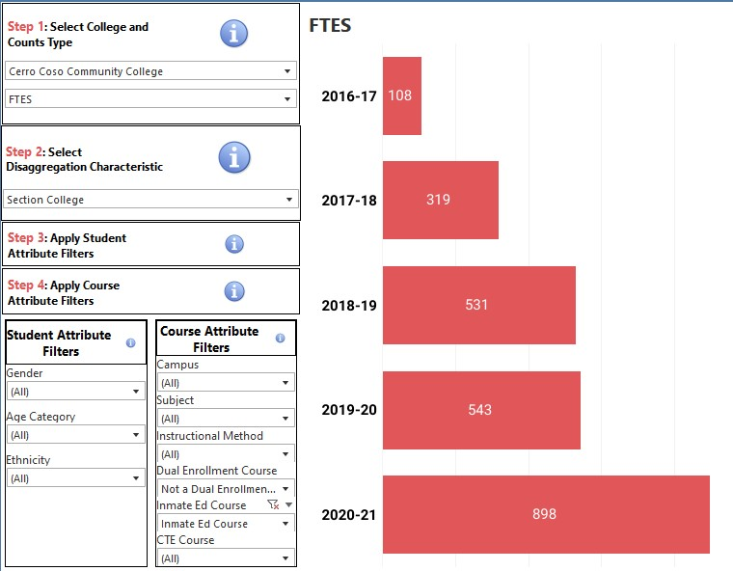
Incarcerated Students Education Program – Peter Fulks
We remain optimistic for a fall return in person
Turnover is one of our primary concerns. We are developing a recruitment approach
Training on 4/9 for canvas launch in prison
Enrollment is strong year over year, but may see a dip when returning in person

Slide 9
Associated Committees

Slide 10
Budget Development – Lisa Couch
Meeting weekly – beginning review of requests

Slide 11
District Wide Budget Development Committee – Lisa Couch
Last met on March 11 – Next meeting on April 8
Considering partial implementation of internal allocation model – SCFF and other revenue piece (hold on District Office / Districtwide piece)
Investment Plan proposals to KCCD Board Finance Committee – distribution of unallocated 2020-21 apportionment.

Slide 12
Institutional Effectiveness Committee (IEC) – Corey Marvin
Has not met. Next meeting Thursday 4/28.

Slide 13
Professional Development Committee – Corey Marvin
Has not met. Next meeting Thursday 4/26.

Slide 14
Accreditation – Corey Marvin
Has not met. Next meeting Thursday 5/3.

Slide 15
The End

